Slide 1
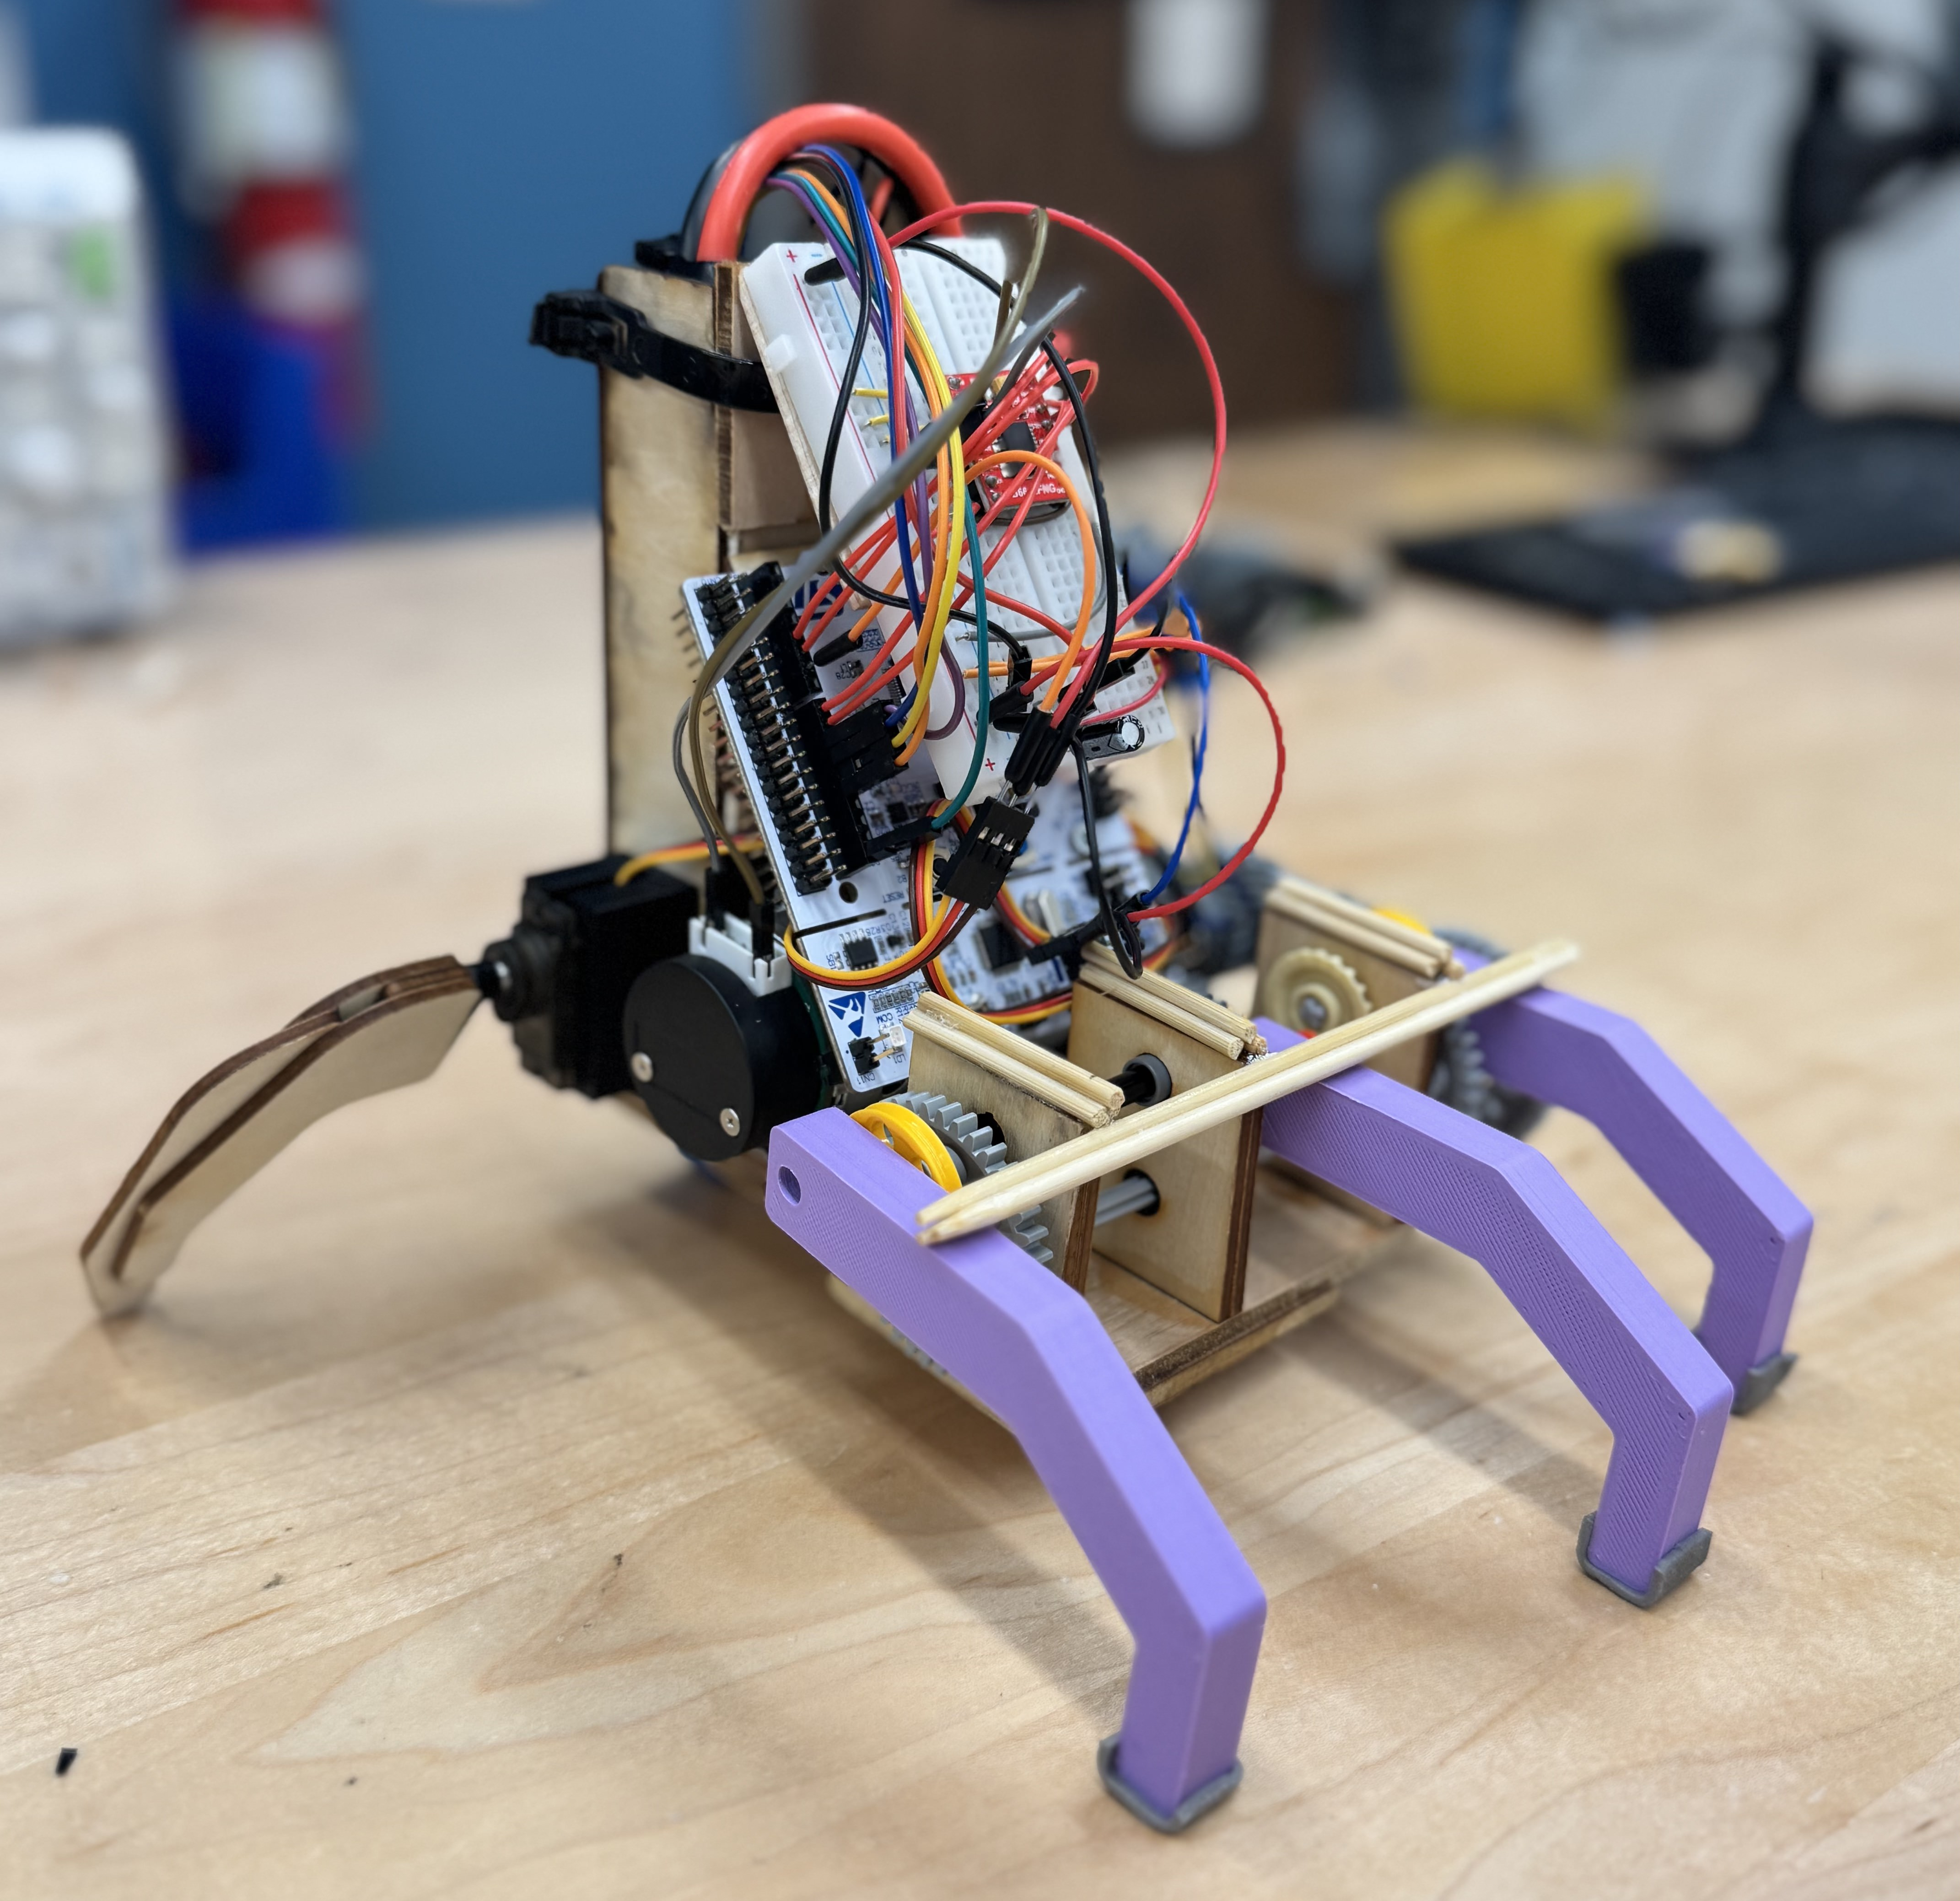
Thing
Nayan Kondakalla, Leah Thomas, Graham Tokarz – Section B03
ME4405 – Fall 2024
Notes:
Introduce ourselves and our project
Everyone
LEAH

Slide 2
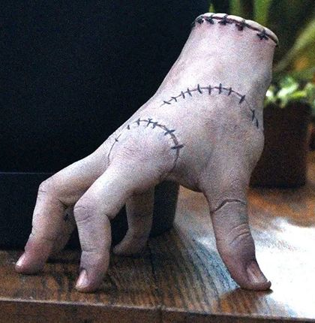
Introduction & Motivation
Our project aims to recreate Thing, the disembodied hand from The Addams Family.
Mimics aspects of prosthetic design by constraining our design to an anatomically accurate shape, while enabling independent movement of select fingers.
The system is designed to move forward and backwards and wave at user.
Controlled remotely via a joystick controller, determining movement and thumb and pinky controls.
Uses the three middle fingers to drag or push the system, providing locomotion.
The thumb and pinky, actuated by servo motors, will provide stability during movement and wave to users.
Notes:
A more in-depth introduction to the project, the overarching goals, and the motivation behind it
LEAH

Slide 3
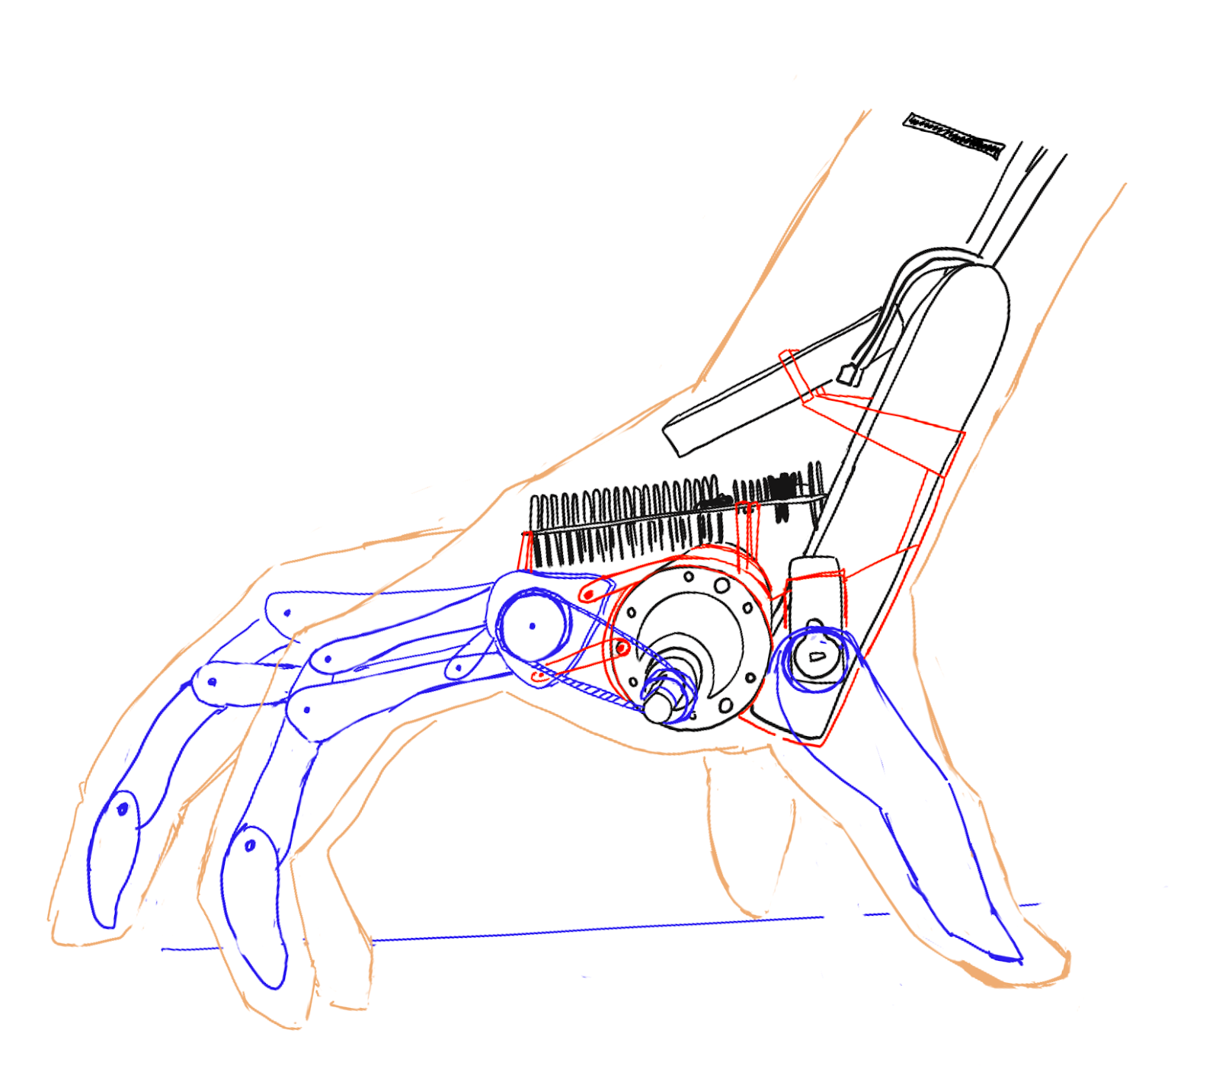
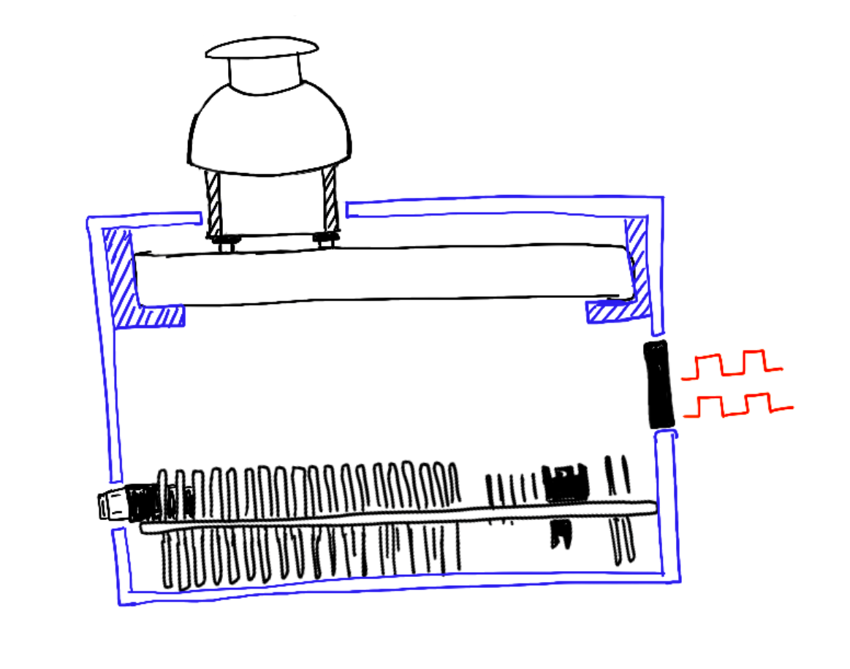
System Snapshot
Subsystem 1: Controller + Transceivers: Communication between joystick and motors of the hand
Subsystem 2: Motors and Hand Structure: Direct Movement of the hand
Transceiver
Receives instructions
from controller
Joystick
Takes user input for
desired hand movement
Transceiver
Sends instructions to hand
Tri-Motor System
Controls finger movement
Notes:
Explain the different subsystems and which sensors and actuators are involved
Explain why we chose specific sensors and actuators
*don’t say the exact name of the parts, unnecessary and loses the audience
LEAH
[Verbally] Briefly describe how your system works (like an elevator pitch)
Our system consists of two main components: the hand and the controller. The controller features a Parallax 2-axis joystick, which sends movement commands to the hand via SPI. Based on these commands, the hand moves forward, backward, or pivots left or right. A DC motor controls the movement of the three middle fingers, while servos operate the thumb and pinky.
What are your sub-systems?
- The first sub-system is the controller, and the second sub-system is the hand’s movement mechanism.

Slide 4
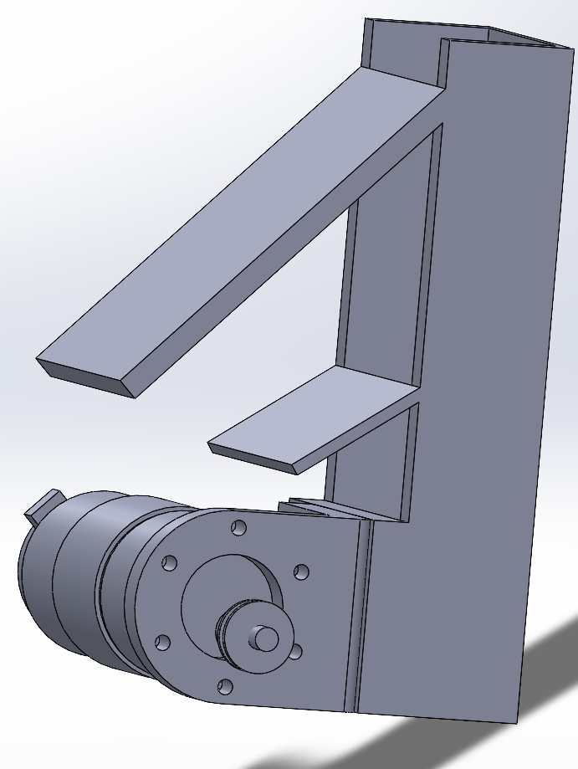
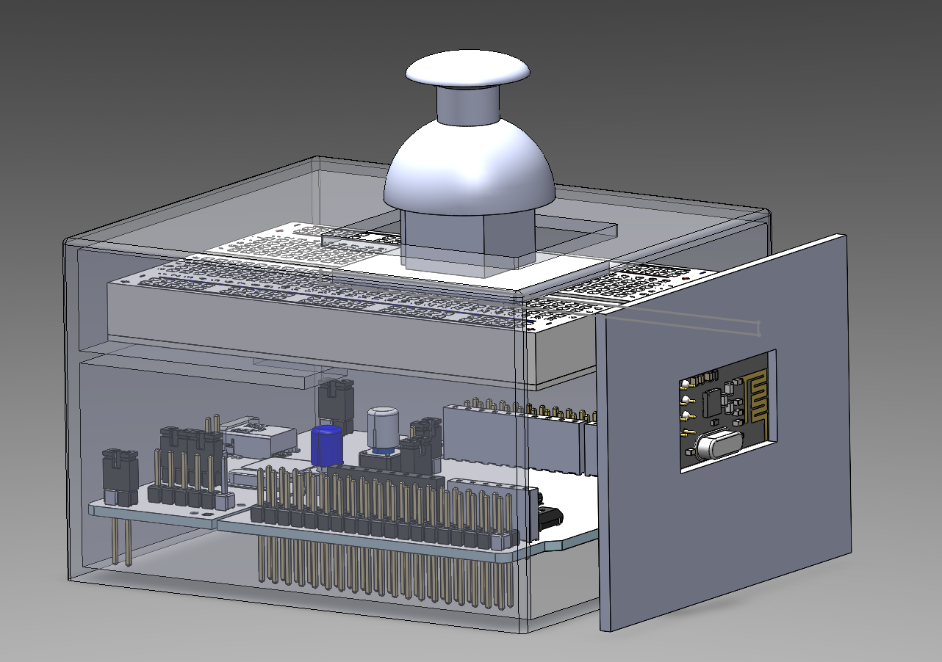
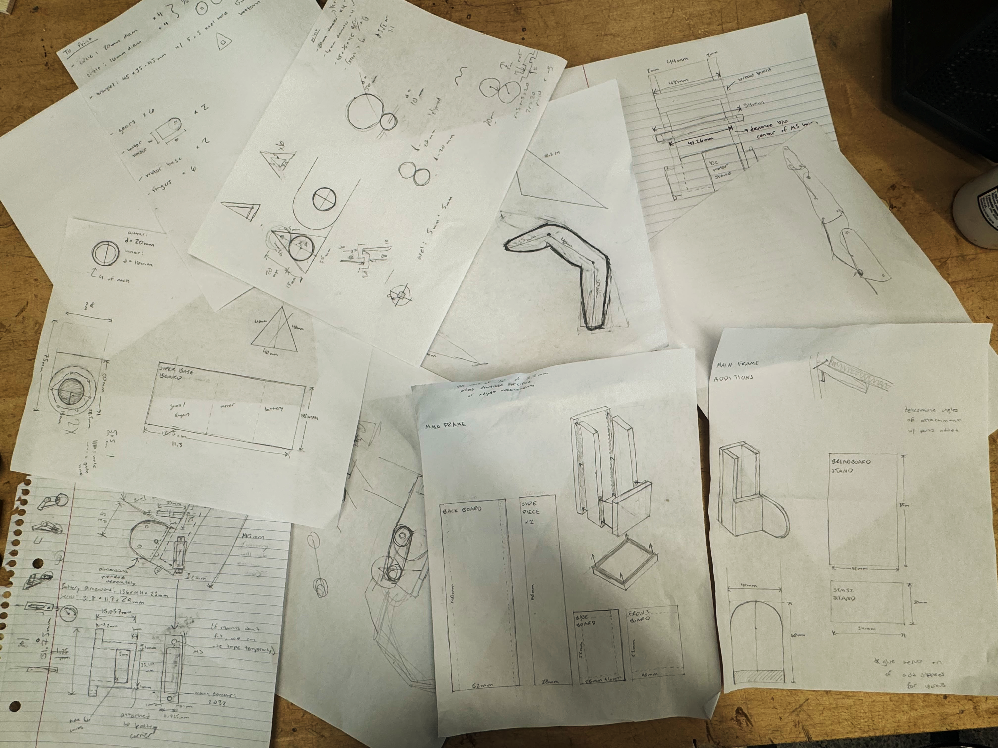
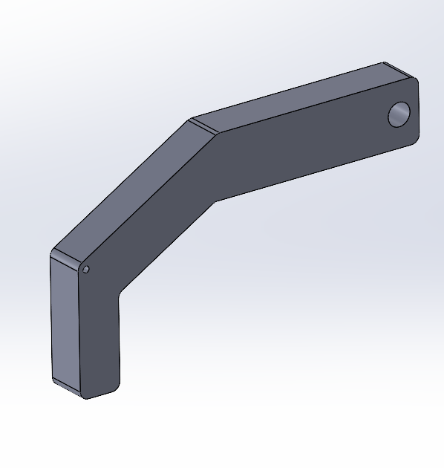
Designs
Fig. 1. Initial sketches for frame, gears, and fingers
Fig. 2. CAD design for remote controller
Fig. 3. CAD designs for finger, hand frame, and motor system

Slide 5
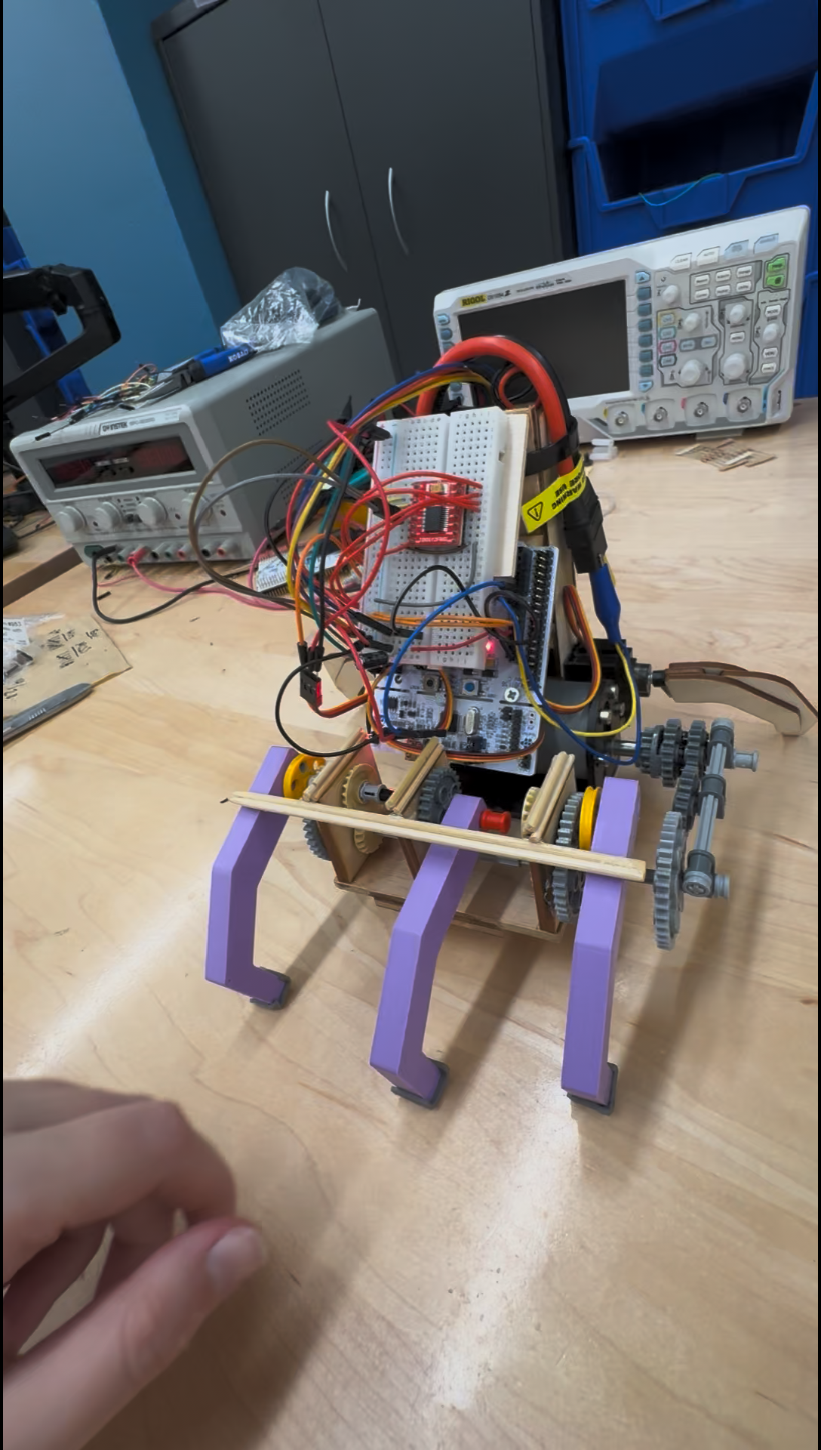
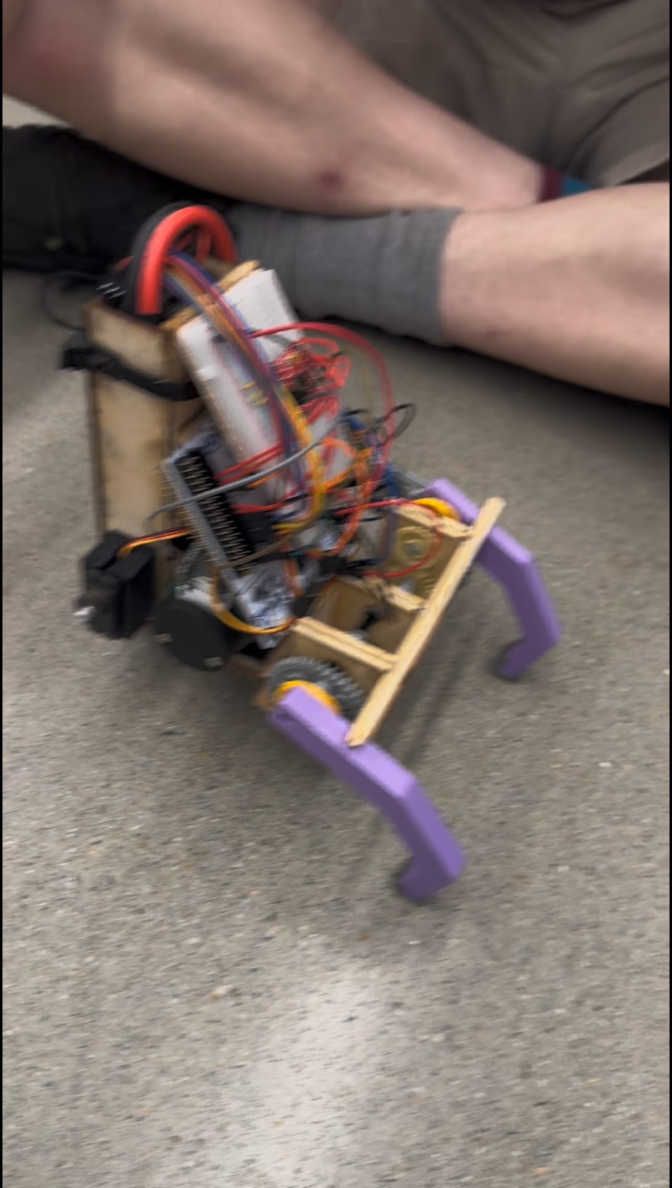
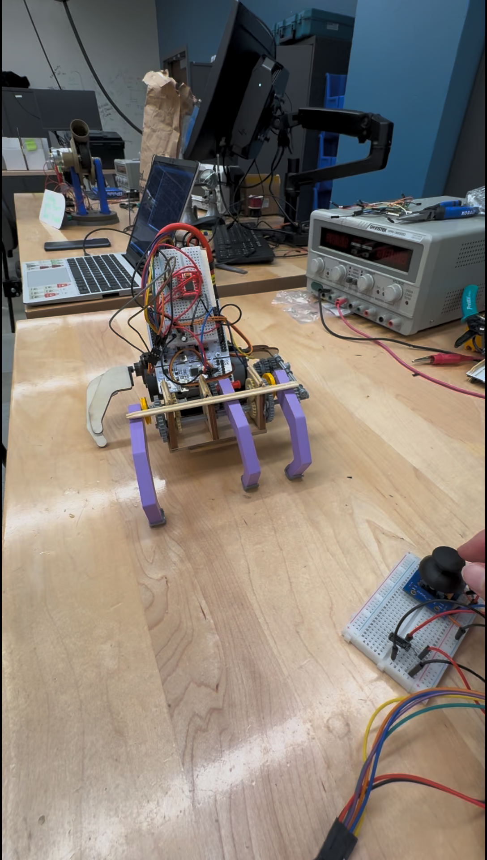
Demonstration
Vid. 1. Successful backwards movement
Vid. 2. Less successful forward movement
Vid. 3. Successful pinky and thumb wave
(via controller)
Notes:
Video / demonstration of hand working
Explain that the joystick controls the movement of the hand
LEAH

Slide 6
How well did the system perform?
The hand will be able to accurately receive and process joystick communications within 100ms of a change.
Duration chosen as 100ms is about the noticeable visual time period for humans.
This was verified using both video recording and clock data from code.
This proved very successful, with an average of 85ms over 10 tests.
The hand will be able to move both forward and backwards steadily for 10s.
Defined as general directional movement, rotational behavior acceptable.
System will not stall or require human intervention in this period.
Was met in isolation multiple times, but not reliably and with enough repeatability to be considered successful.
Notes:
Explain how performance metrics and how will the system did
GRAHAM

Slide 7
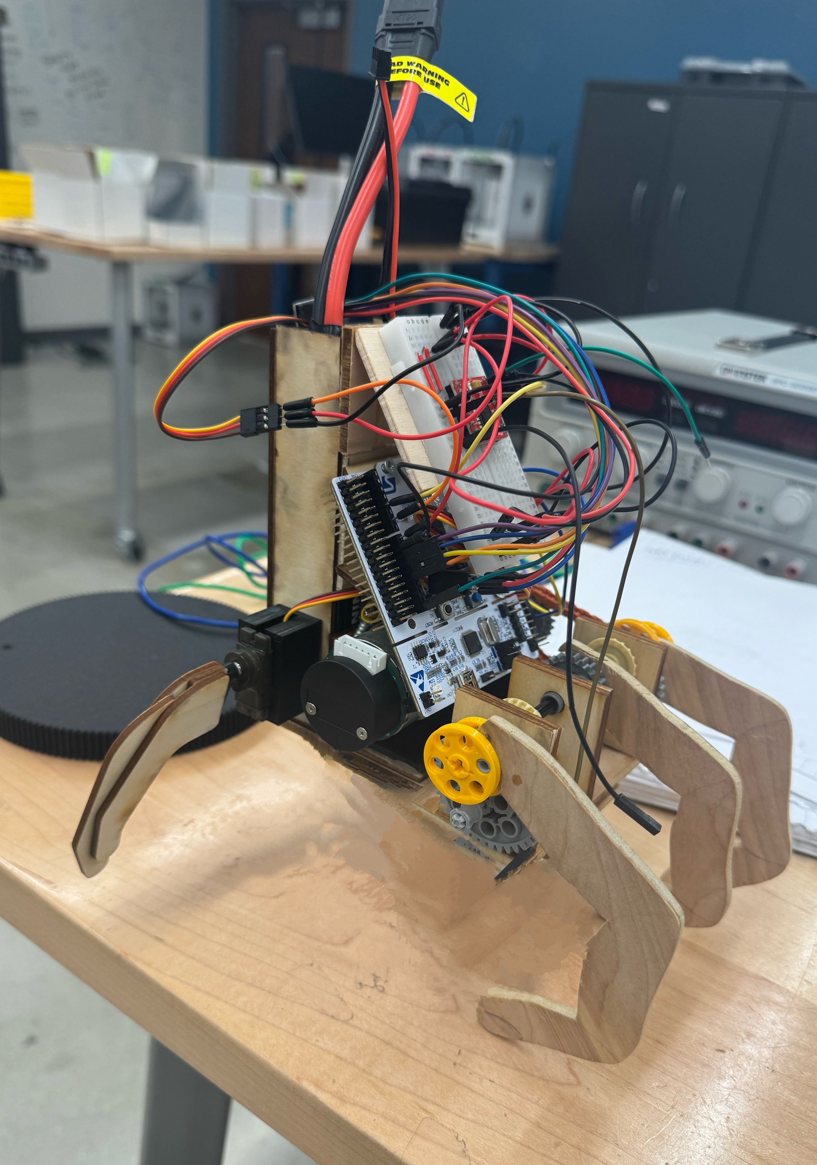
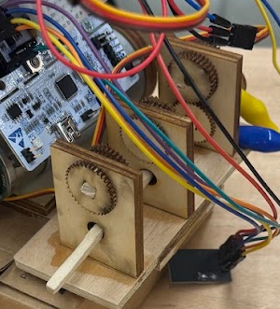
Challenges Encountered
Mainly Mechanical Issues
Initially used fully-wooden gear system
Too much friction --> Switched to Technic Plastic Gears
Driving Gear Design constantly changed as more needs were discovered through iterations
Fingers
Had to determine smallest size of fingers/thumbs that allow for movement without drastically increasing weight
Size Constraint
Originally had the size constraint of average human hand, however individual components increased project size
Need more powerful motor to counteract weight and bigger battery for increased power consumption
Fig. 4. Early iteration of gear and finger system
Notes:
Discuss challenges, focus on tech
NAYAN

Slide 8
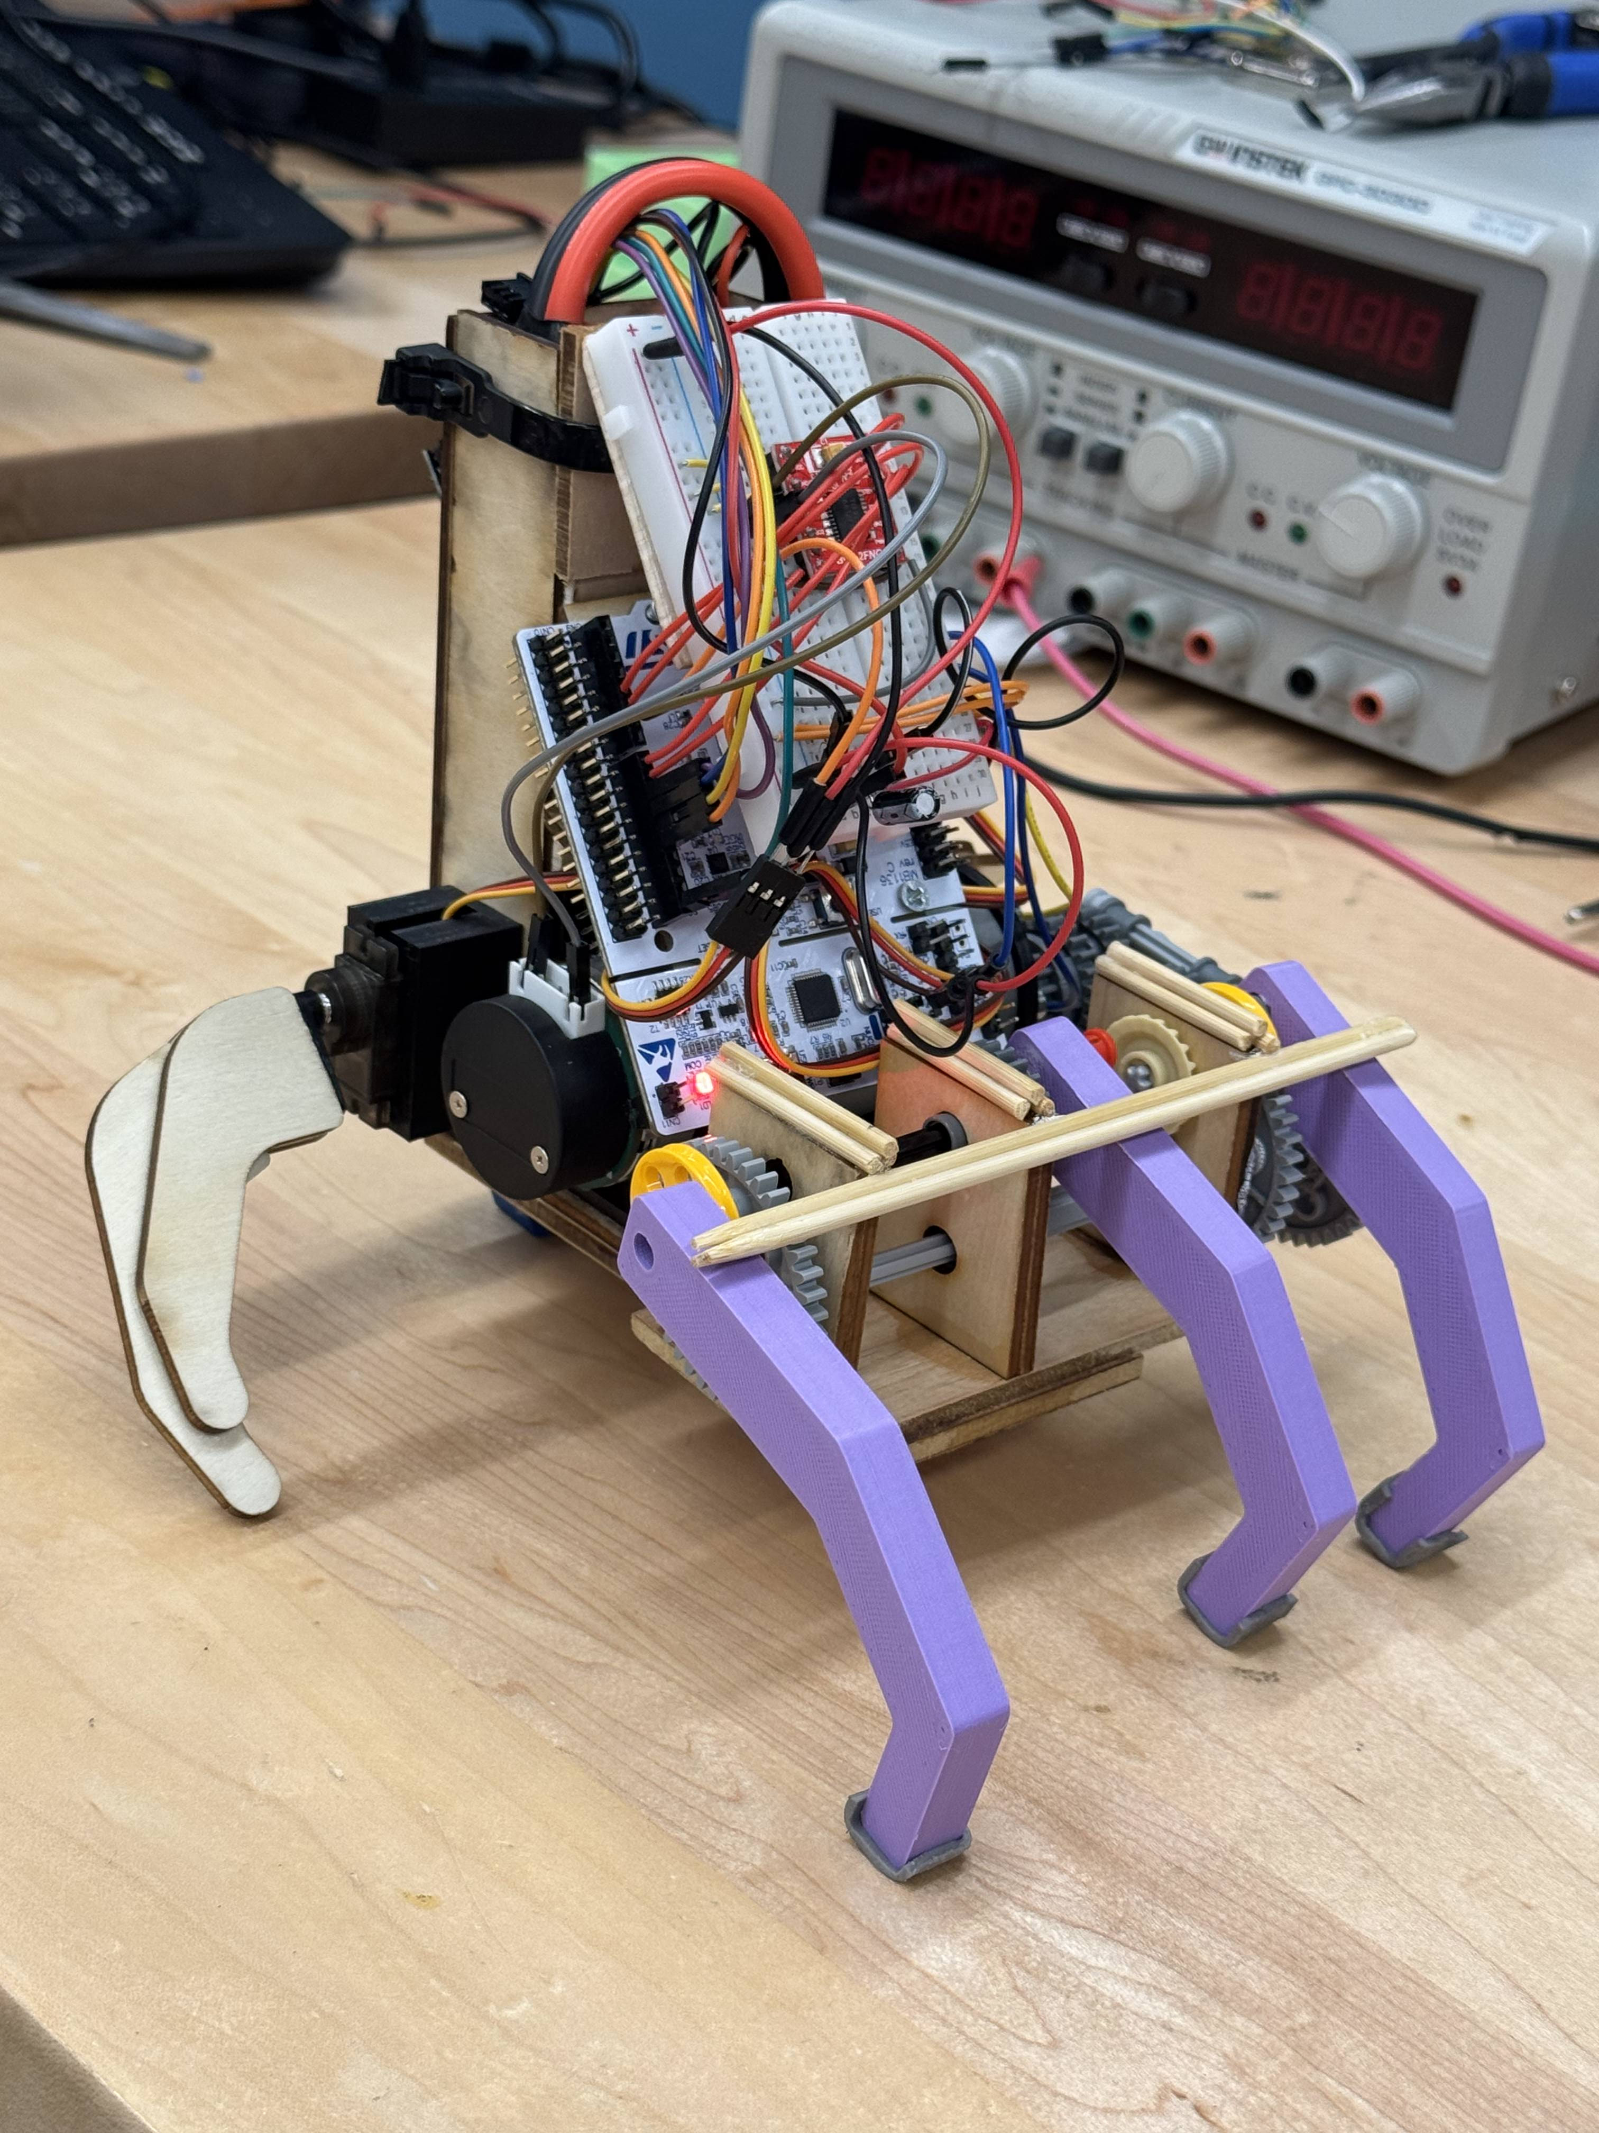
Conclusion
Final concluding statement: “We've wandered too far in — excellent.”
Wednesday Addams
Project Scope was massive considering timeframe
Learned how to choose design requirements and "nice-to-haves"
We learned about RF transmission
How gear mechanism interact with motor drivers
Further Steps:
Silicone Wrapping Hand for Skin-Like Covering`
Redesign Finger/Gear system to more accurately reflect finger joint movements
Complete redesign of gear system to allow for more robust/smoother movement
Notes:
Discuss challenges, focus on tech
NAYAN

Slide 9
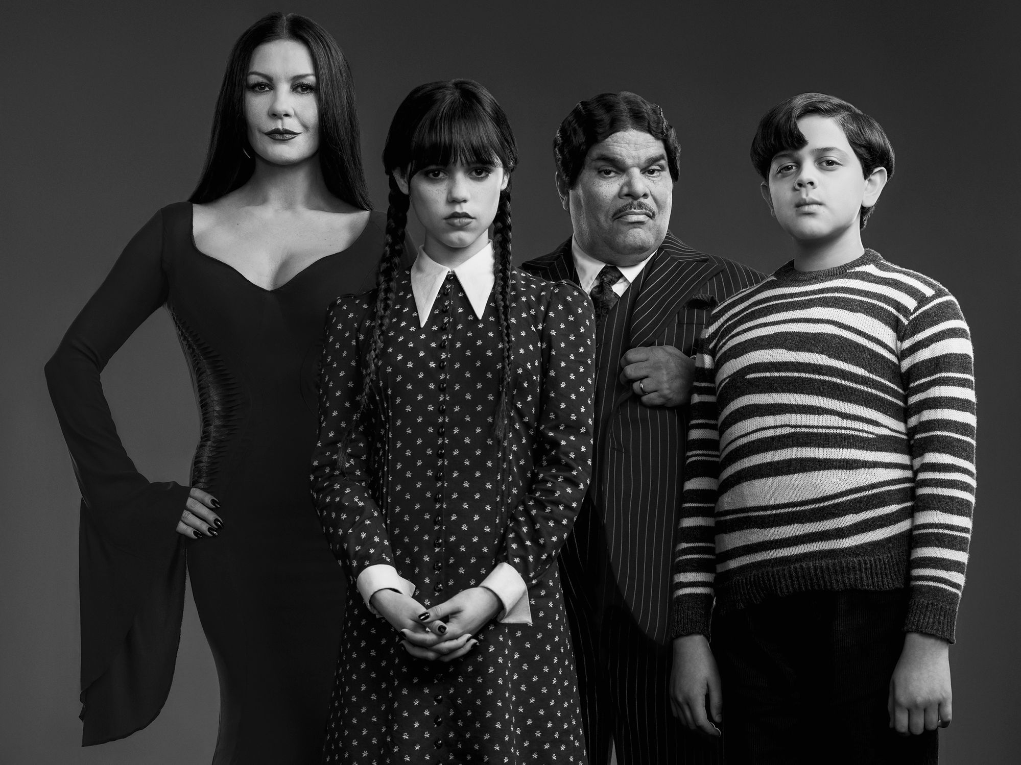
THANK YOU!!
Notes:
NAYAN

